Slide 1

JavaScript Programming
Information Technology
user input

Slide 2


Slide 3
User Input using prompt
Use the prompt() method for creating a dialog box that accepts user input
The prompt method accepts 2 arguments
message & a default value
These are optional parameters (Not required)

Slide 4
User Input using prompt
<!DOCTYPE html> <html>
<head> <script>
let myName = prompt(“Please provide your name”,”Name here”);
alert(myName); </script> </head> <body>
<h1>A Web Page</h1> <p>A web page with embedded JavaScript</p>
</body> </html>

Slide 5
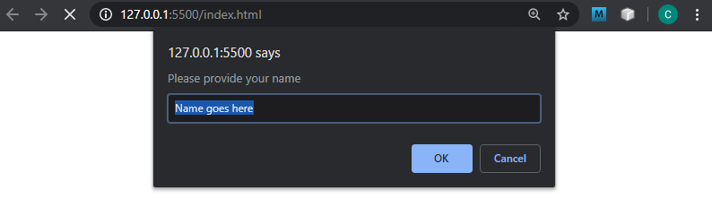
Default value
Page execution waits for Ok click.

Slide 6
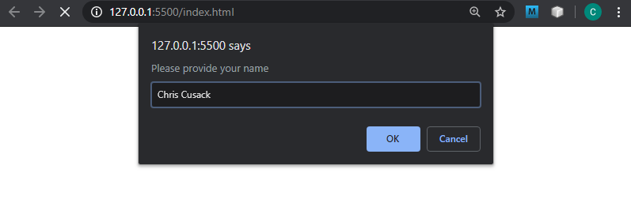
User Input
Click OK sets value of user input to declared variable

Slide 7
User Input using prompt
<!DOCTYPE html> <html>
<head> <script>
let myName = prompt(“Please provide your name”,”Name here”);
alert(myName); </script> </head> <body>
<h1>A Web Page</h1> <p>A web page with embedded JavaScript</p>
</body> </html>
In our example, myName variable is now equal to Chris Cusack

Slide 8
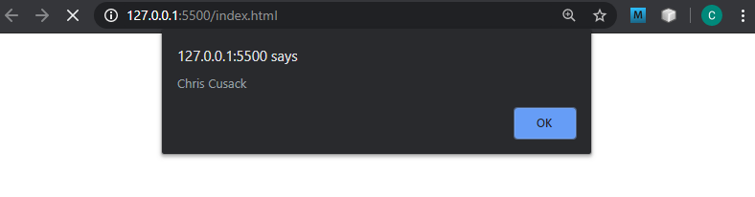
alert displays value of myName variable

Slide 9
User Input using prompt
<!DOCTYPE html> <html>
<head> <script>
let myName = prompt(“Please provide your name”,”Name here”);
alert(myName); </script> </head> <body>
<h1>A Web Page</h1> <p>A web page with embedded JavaScript</p>
</body> </html>
alert method displays data sent to it in a pop up in the browser. Like a C# MessageBox.Show()

Slide 10
User Input using prompt
<!DOCTYPE html> <html>
<head> <script>
alert(2 * 3); </script> </head> <body>
<h1>A Web Page</h1> <p>A web page with embedded JavaScript</p>
</body> </html>

Slide 11
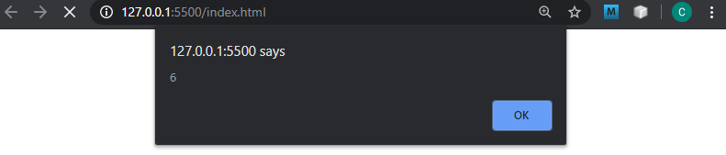

Slide 12
The window.location property
We can redirect a user to another page using window.location
Set the window.location to the page you wish to redirect to
<!DOCTYPE html> <html>
<head> <script>
window.location = ‘myOtherPage.html’;
</script> </head>
…

Slide 13
The window.location property
window.location is not a replacement for <a> tags!!!

Slide 14
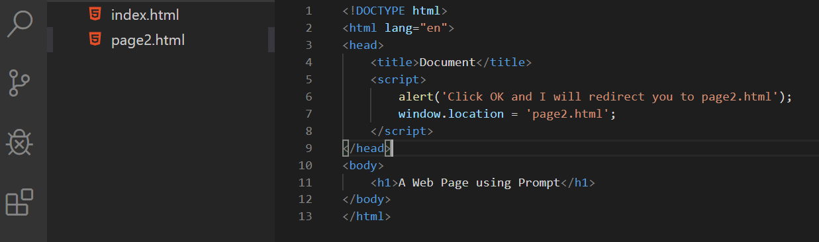

Slide 15
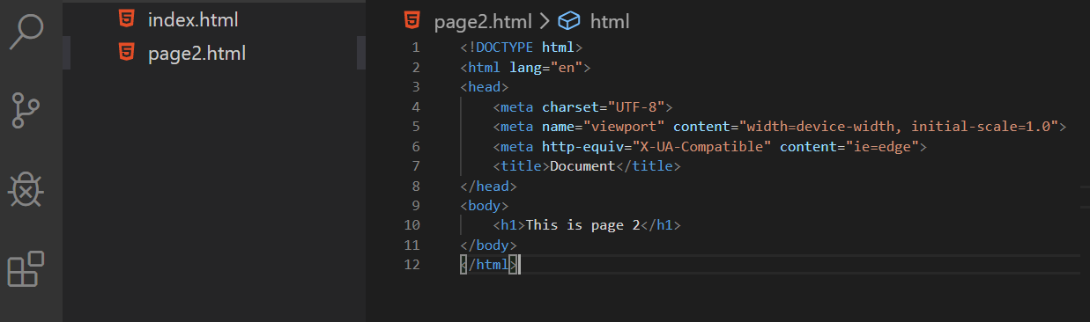

Slide 16
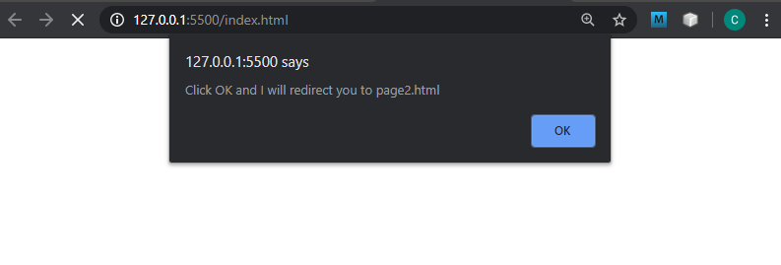
Execution halted. Click OK will then hit the window.location code and we will be redirected to page2.html

Slide 17
